Slide 1
DENSITY BASED TRAFFIC LIGHT CONTROL SYSTEM

Slide 2
Gather the necessary components:
Arduino Uno board
Ultrasonic sensor (HC-SR04)
Breadboard and jumper wires
Two traffic lights (red, yellow, and green LEDs)
Resistors (220-ohm) for LED current limiting

Slide 3
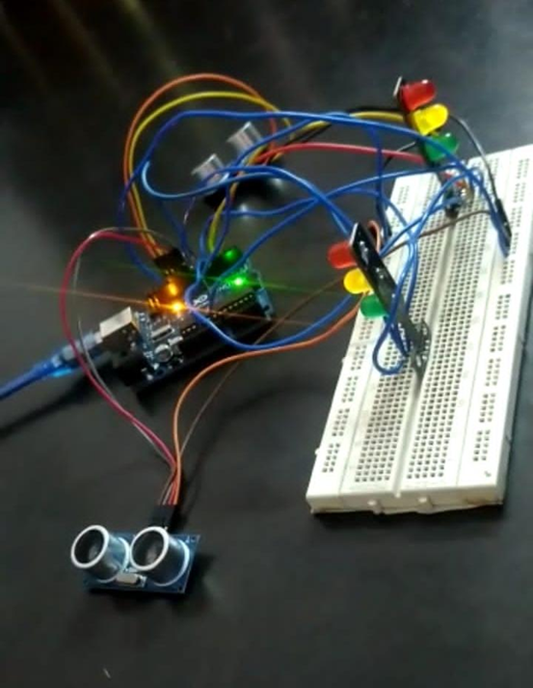
The density-based traffic light control system is designed to regulate traffic flow at an intersection based on the density of vehicles approaching from both directions. The system uses an Arduino Uno microcontroller and an ultrasonic sensor to measure the distance between vehicles and adjust the traffic lights accordingly.

Slide 4
The Arduino Uno is the brain of the system, responsible for reading the sensor data and controlling the traffic lights. The ultrasonic sensor is used to measure the distance between the sensor and an approaching vehicle. By analyzing the distance, the system can estimate the density of traffic. The circuit is set up by connecting the ultrasonic sensor's VCC and GND pins to the 5V and GND pins of the Arduino Uno, respectively. The Trig and Echo pins of the sensor are connected to digital pins on the Arduino. The LEDs of the traffic lights are connected to digital output pins of the Arduino through current-limiting resistors. The anodes (longer legs) of the LEDs are connected to the Arduino pins, and the cathodes (shorter legs) are connected to GND.

Slide 5
The Arduino code is written to control the traffic lights based on the measured distance. The code defines pin assignments for the ultrasonic sensor and the traffic light LEDs. It also sets distance thresholds for low and high traffic density. In the main loop of the code, the ultrasonic sensor generates a pulse to measure the distance. The pulse duration is measured, and the distance is calculated based on the speed of sound. The distance is then used to determine the traffic density.

Slide 6
If the distance is above the high threshold, indicating high traffic density, both traffic lights turn red to stop vehicles from both directions. If the distance is above the low threshold but below the high threshold, indicating medium traffic density, one side of the intersection will have a red light while the other side will have a green light. This allows vehicles from one direction to flow while vehicles from the other direction are halted. If the distance is below the low threshold, indicating low traffic density, both traffic lights turn green to allow vehicles from both directions to proceed.

Slide 7
The system continuously monitors the traffic density and adjusts the traffic lights accordingly, ensuring efficient traffic flow and reducing congestion at the intersection.
By implementing this density-based traffic light control system using Arduino Uno and an ultrasonic sensor, you can create a smart and responsive solution to manage traffic at a two-way intersection based on real-time conditions.

Slide 8
THANK YOU

